Slide 1
Customer Churn Prediction
(Neural Network From Scratch)
By Muddasar Razzaq

Slide 2
Project Overview
- Predict customer churn (Exit or Stay)
- Manual preprocessing, encoding, scaling
- Forward pass, backpropagation, gradient descent
- Evaluate on test dataset

Slide 3
Dataset Description
- 10,000 customer records
- Features: CreditScore, Geography, Gender, Age,
Tenure, Balance, Products, Credit Card, Activity, Salary
- Target: Exited (1 = churn, 0 = stay)
- Imbalanced (approx. 20% churn)

Slide 4
Data Preprocessing
- Drop ID-like columns
- Encode Gender manually (0/1)
- One-hot encode Geography
- Standardize numerical features
- Manual train-test split (80/20)

Slide 5
Neural Network Architecture
- Architecture: Input → 16 → 8 → Output
- Hidden Layers: ReLU activation
- Output Layer: Softmax
- Loss: Categorical Cross-Entropy
- Optimization: Gradient Descent

Slide 6
Forward & Backpropagation
Forward Pass:
- Z1 = ReLU(XW1 + b1)
- Z2 = Softmax(Z1W2 + b2)
Backpropagation:
- Compute gradients for W and b
- Update parameters using Gradient Descent

Slide 7
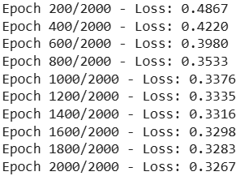
Training Loss Curve Insights
- Loss decreases from ~0.70 → ~0.33
- Smooth convergence
- No overfitting observed
- Indicates stable learning

Slide 8
Model Performance
Training Accuracy: 86.3%
Test Accuracy: 85.7%
Interpretation:
- Good generalization
- Solid baseline for a manually built ANN

Slide 9
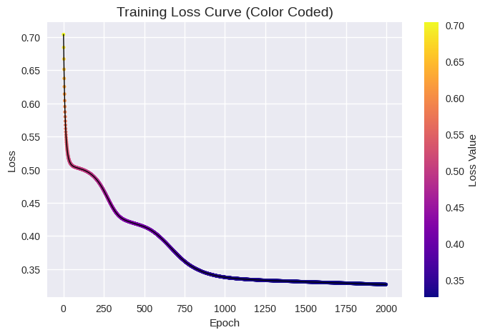

Slide 10
Business Insights
- Older customers have higher churn probability
- German customers churn more
- Active members churn less
- High balance customers usually stay

Slide 11
Conclusion
- Complete ML pipeline built manually
- Strong performance and clear insights
- Demonstrates deep understanding of ANN fundamentals
- Ready to extend with tuning or deployment

